Slide 1
Photocurrent enhancement

Slide 2
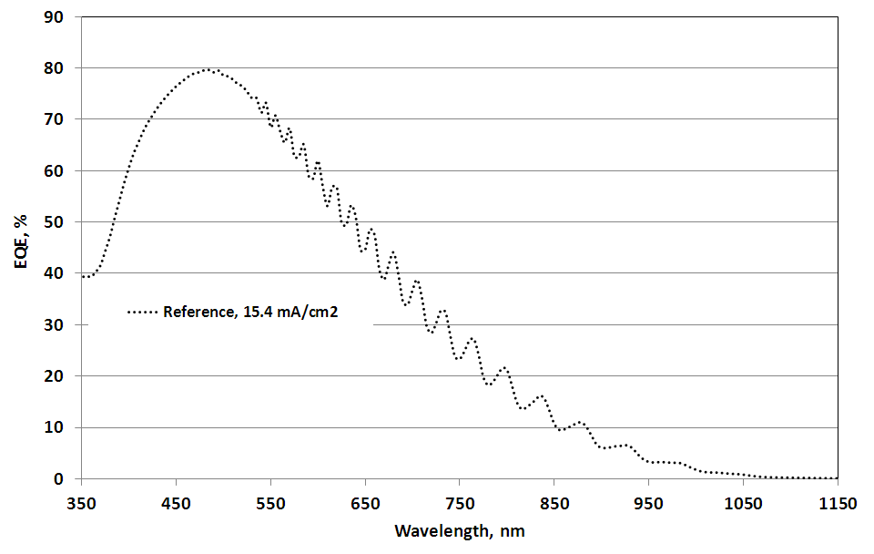
Photocurrent enhancement

Slide 3
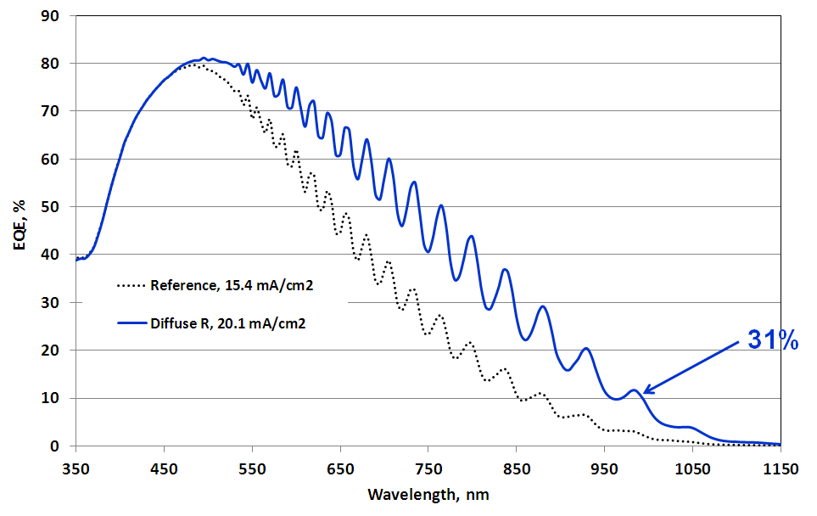
Photocurrent enhancement

Slide 4
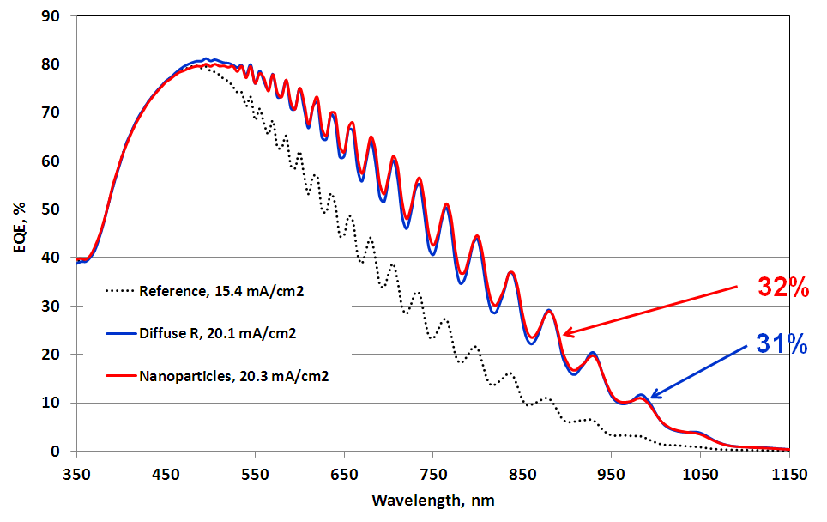
Photocurrent enhancement

Slide 5
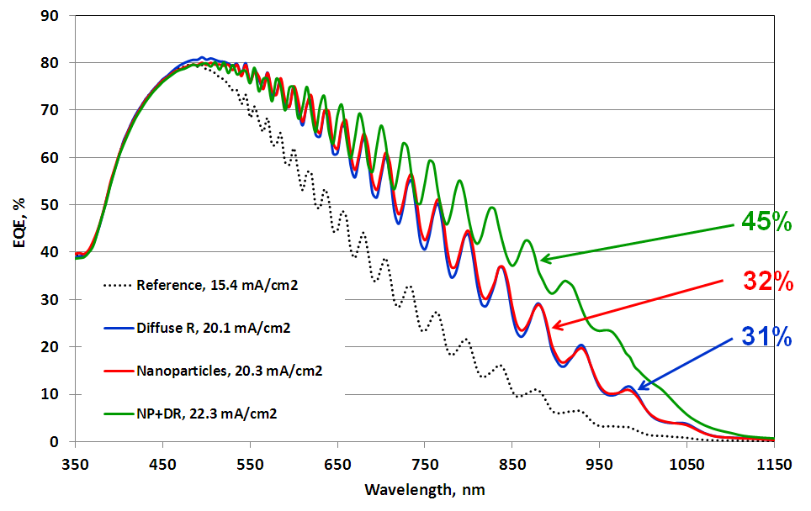
Photocurrent enhancement

