Slide 1
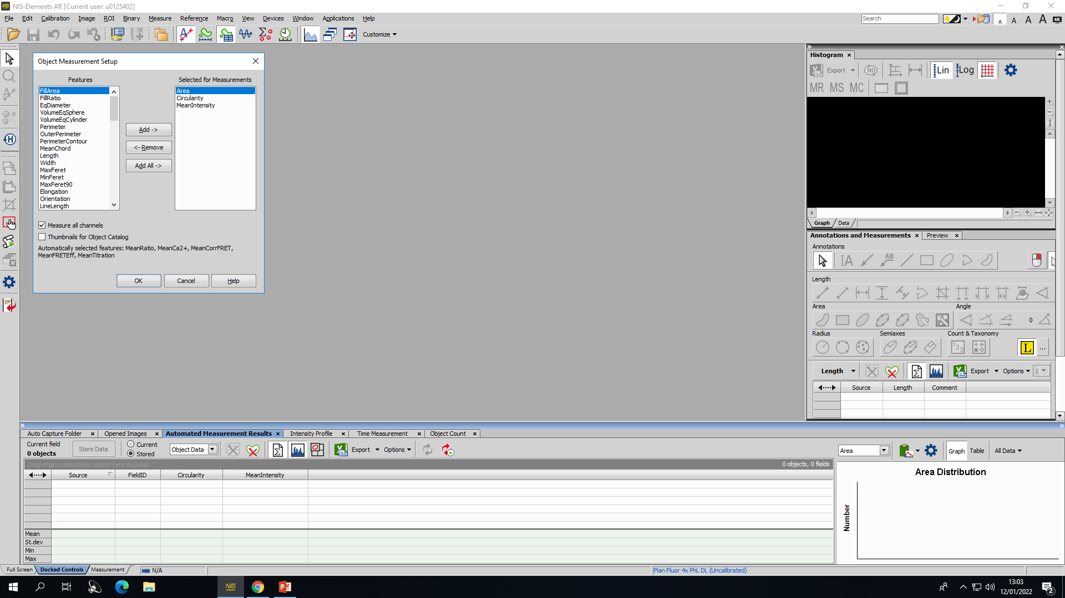
*
(A) Right-click the grey bar above the results section (red asterisk) to set up parameters for object measurement. Add circularity and mean intensity.

Slide 2
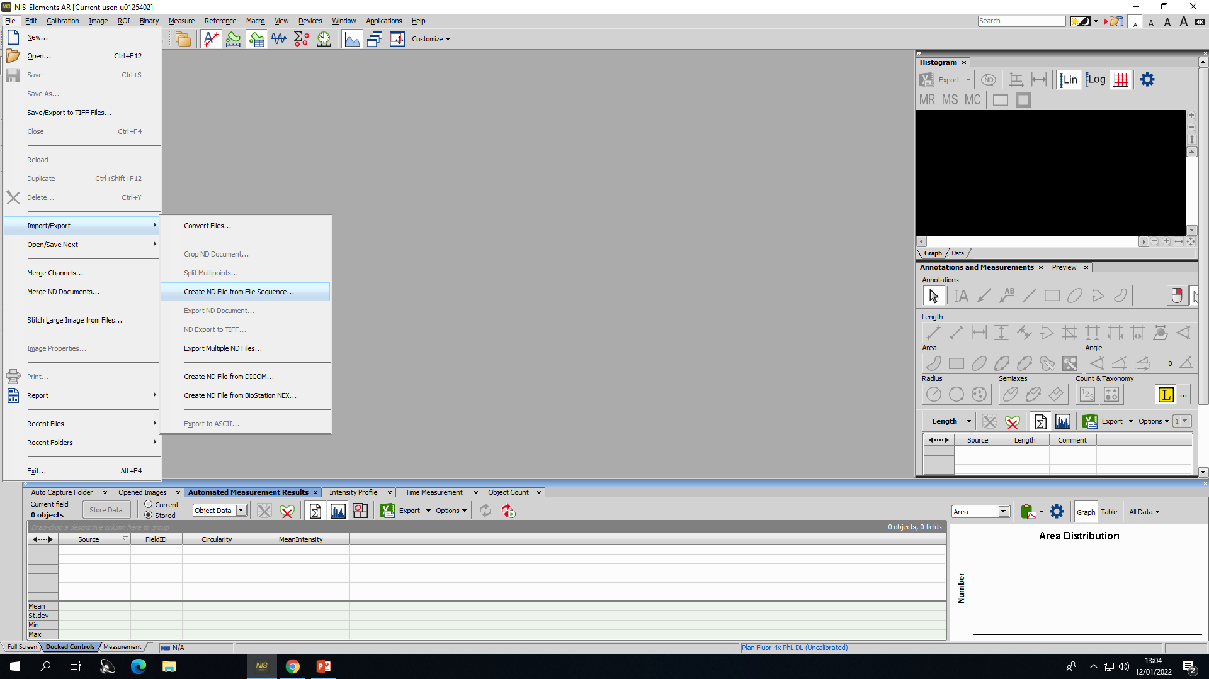
(B) Click on File > Import/Export > Create ND file from file sequence to combine the TIFF files for one culture into one ND file.

Slide 3
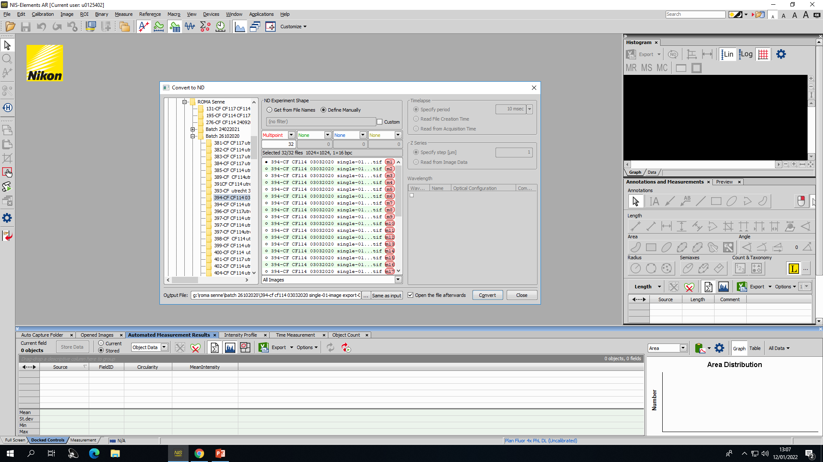
*
(C) Select the desired file and confirm; 32 pictures will be combined (red asterisk).

Slide 4
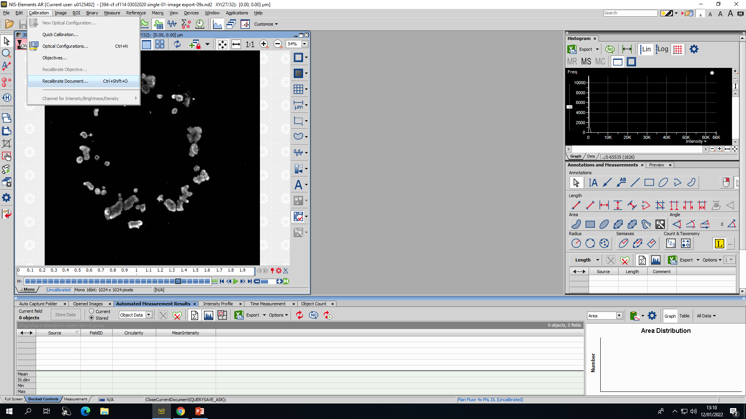
(D) Click Recalibration > Recalibrate Document.

Slide 5
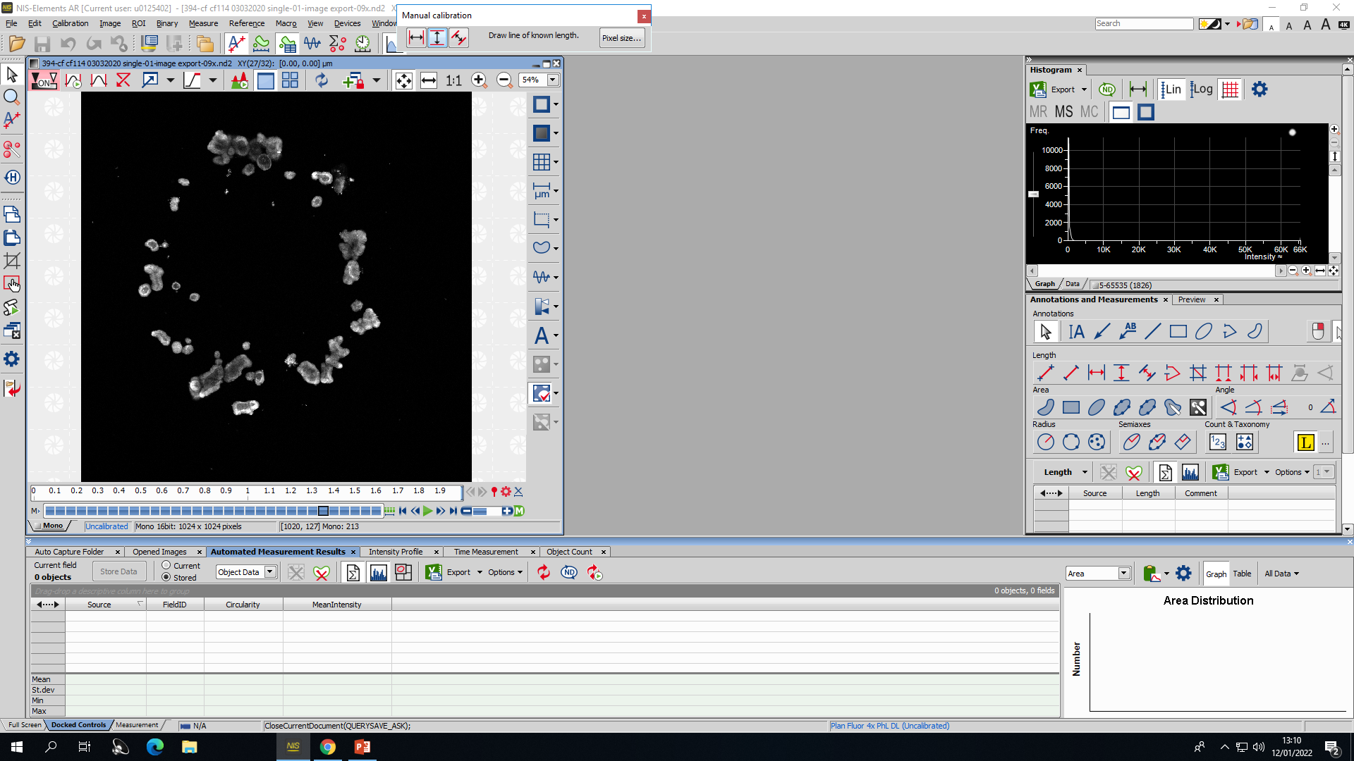
(E) Click on Pixel Size in the pop-up window.

Slide 6
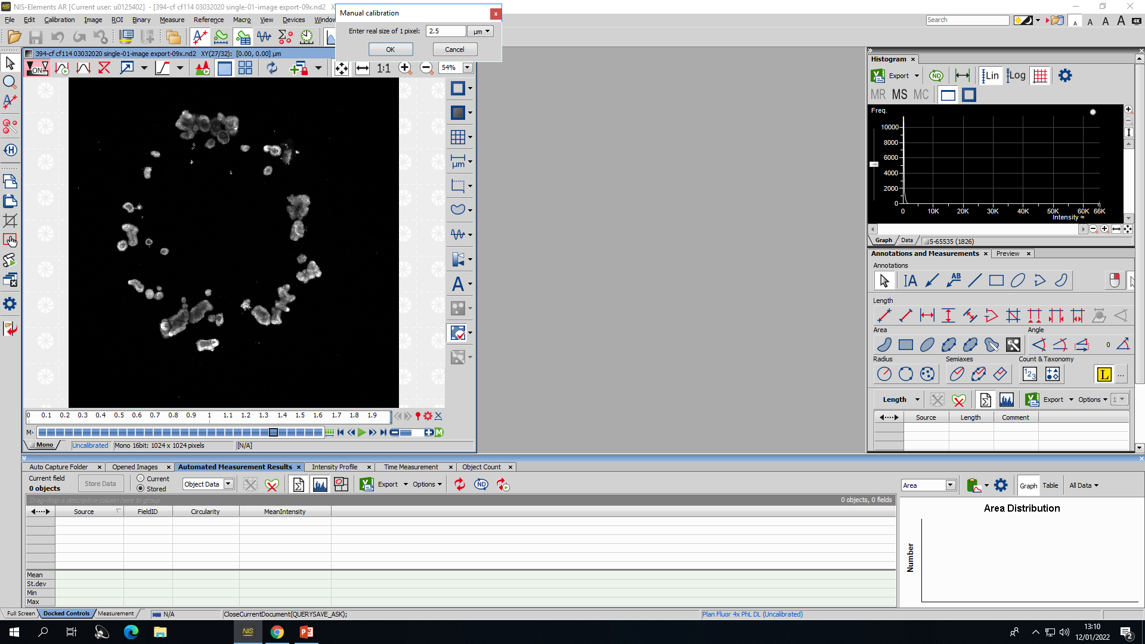
(F) Input 2.5 µm as the size of 1 pixel.

Slide 7
*
(G) The picture will now be recalibrated to micrometers instead of pixels (red asterisk).

Slide 8
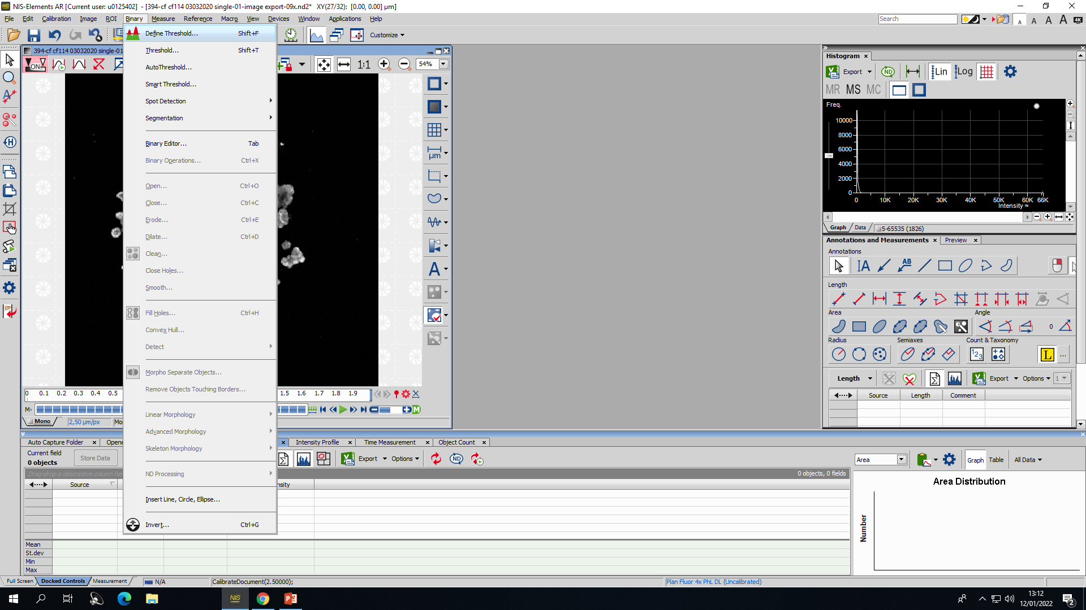
(H) Click Binary > Define Threshold.

Slide 9
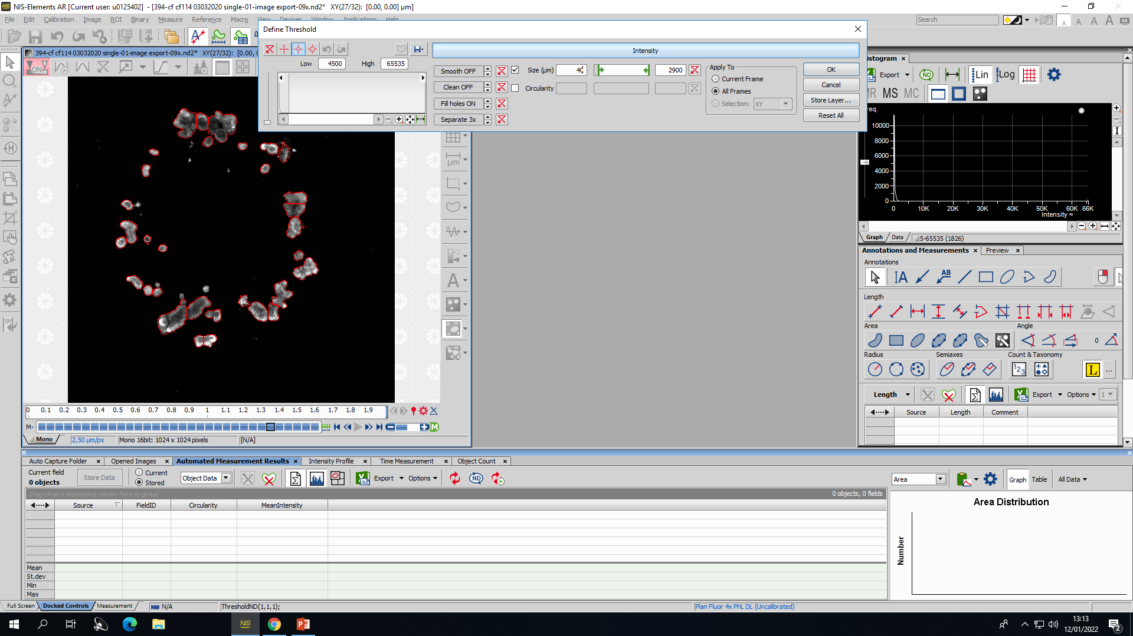
(I) Size selection can be performed in the pop-up window. The minimum size is 40 µm for organoid counting and 60 µm for organoid morphology analysis. Always turn off the Smooth and Clean function, turn on the Fill Holes function, and input Separate x3. Apply to all frames.

Slide 10
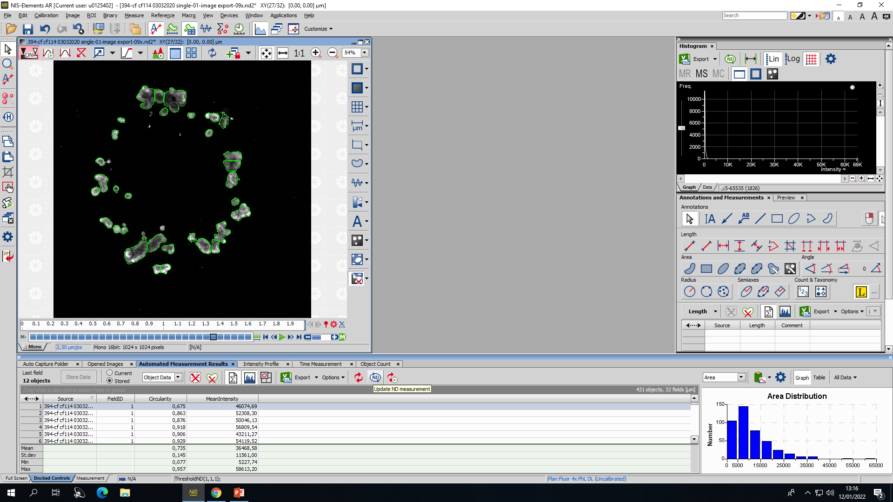
(J) The software will show delineation of the defined structures. Click on the Update ND Measurement button to analyze and get the chosen parameters from step A as output.

Slide 11
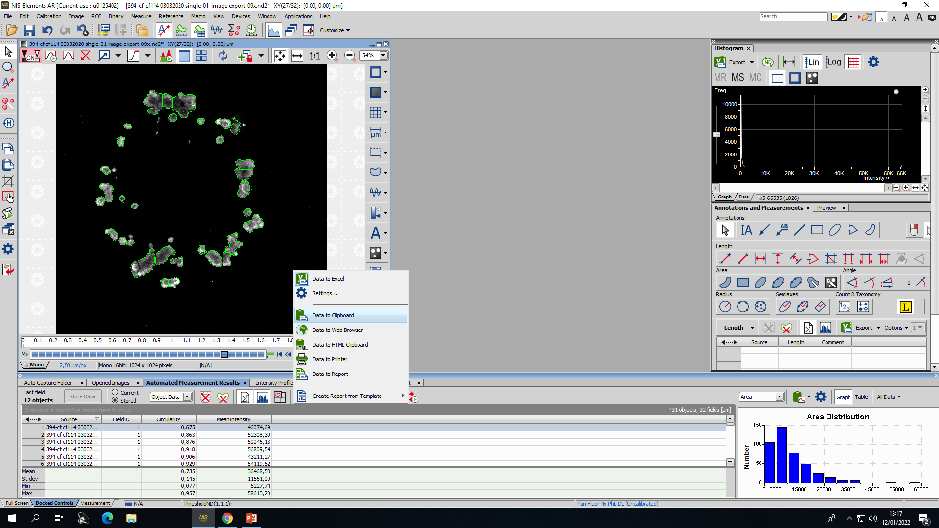
(K) Click the downward facing arrow next to the export button and select data to the clipboard.

Slide 12
(L) Click on the Export button to copy the data output to the clipboard. Data can now be pasted to a spreadsheet.

Slide 13
(M) Click on the Reset Data button to empty the results section before a new measurement is performed.

Slide 14
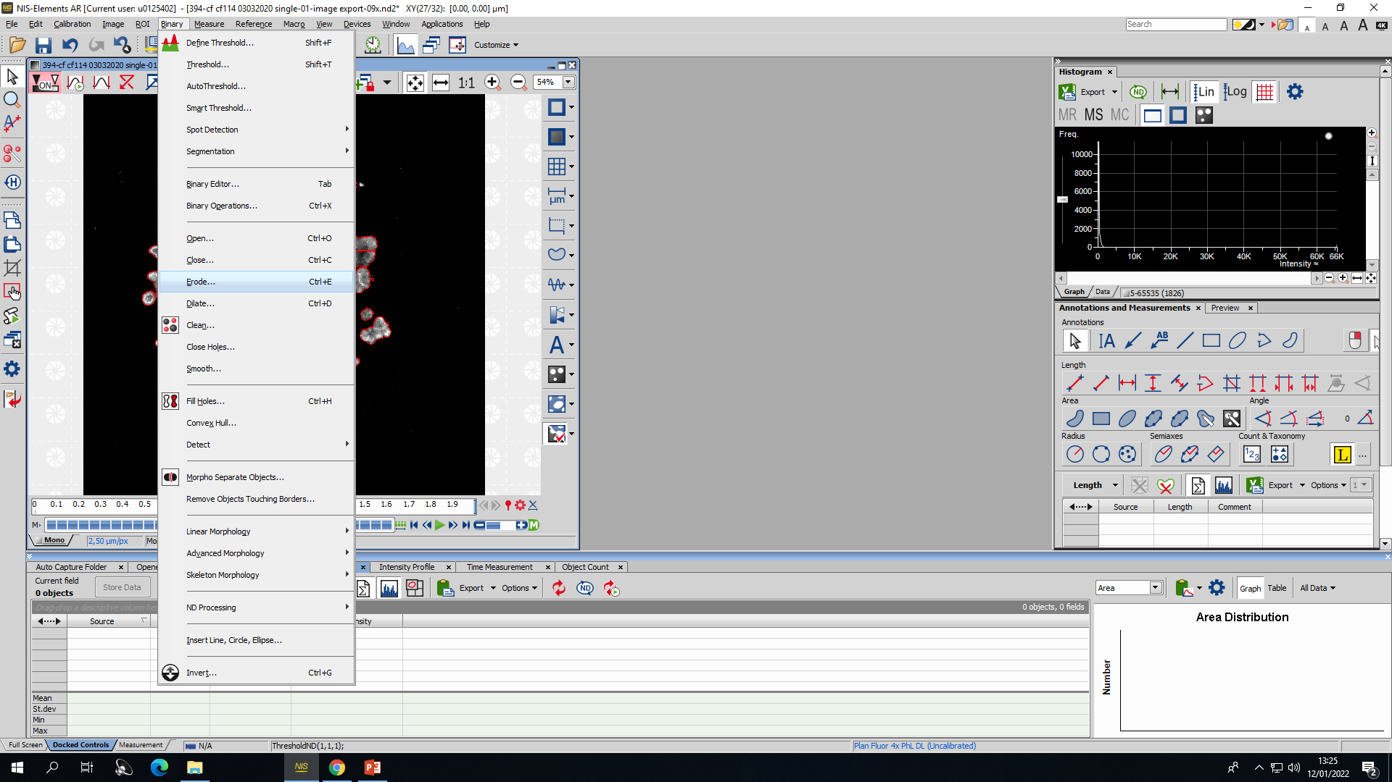
(N) When erosion has to be performed for intensity measurement for calculation of the intensity ratio, click Binary > Erode. The Remove Objects Touching Borders function can be found in the same drop-down menu.

Slide 15
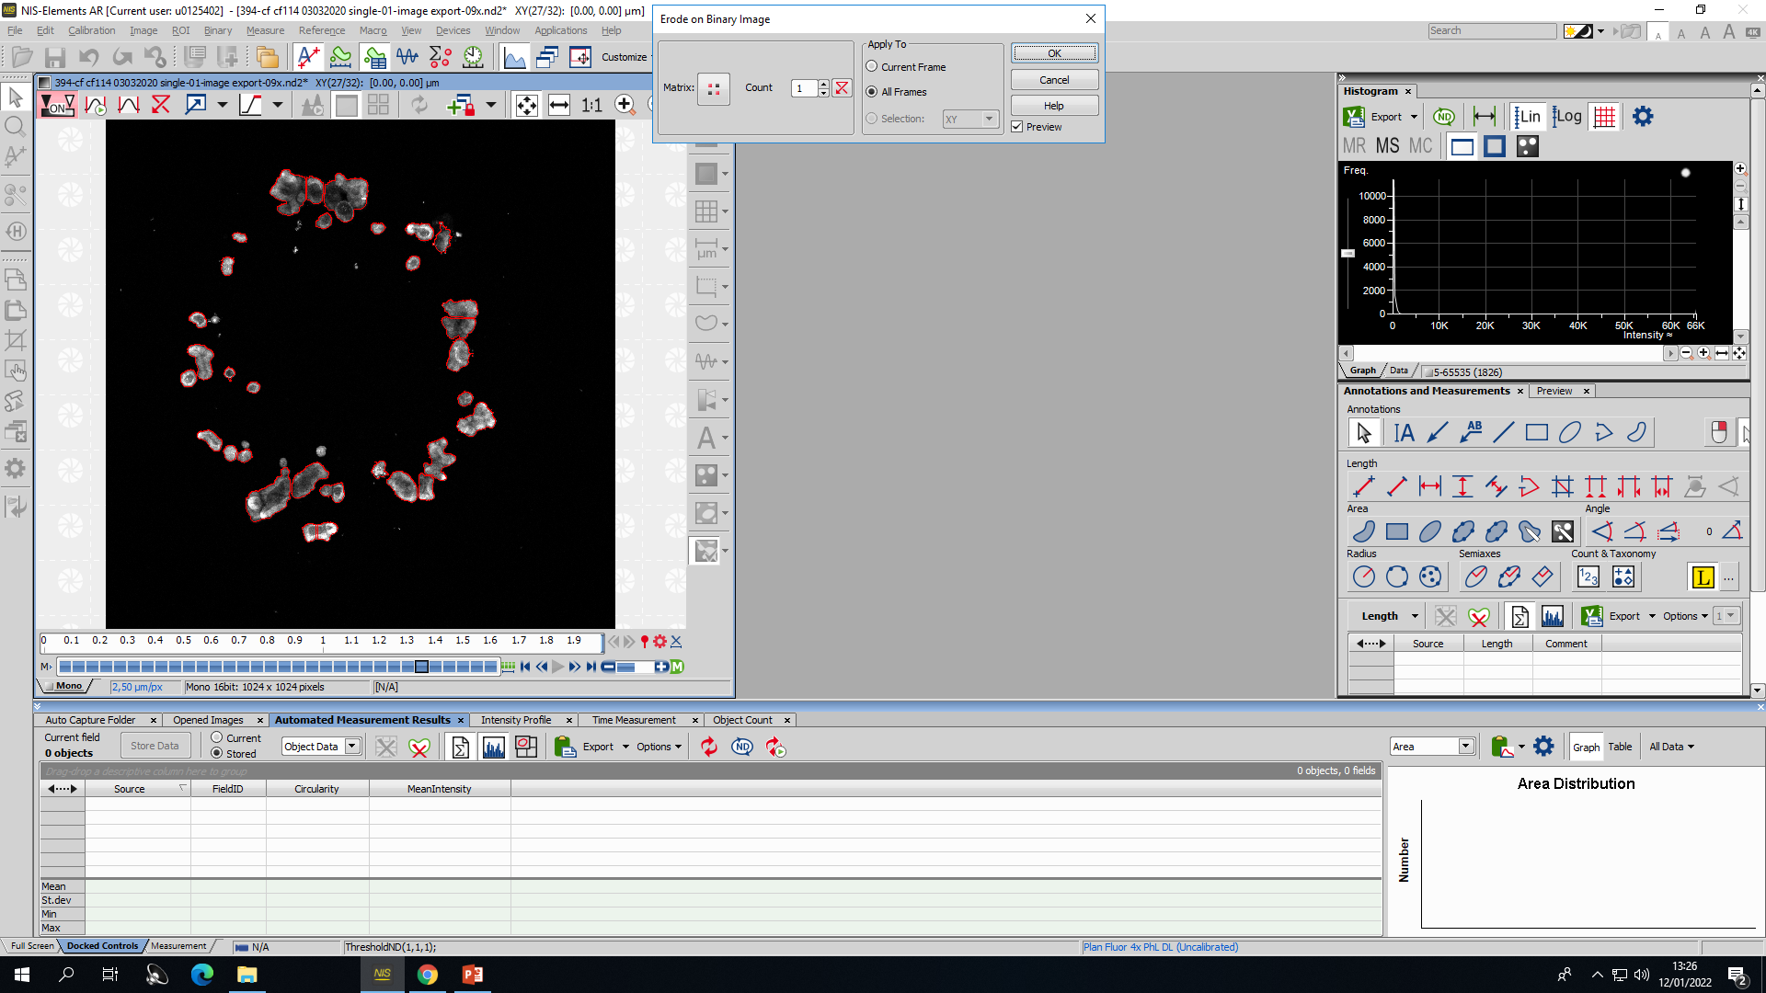
(O) Select the matrix shown in the figure for erosion, and choose the desired count (1 pixel or 2.5 μm for removal of the halo surrounding organoids, 10 pixels or 25 μm for removal of the cellular border surrounding a lumen if present).

